Slide 1
Survival analysis for AIDS Clinical
----By Dong Yanli

Slide 2
Research : The data comes from a double-blind, placebo-controled trial that compared drug regimen in two treatment groups (Control group (treatment regime without IDV) , Treatment includes IDV )HIV-infected patients . Patients were eligible for the trial if they had no more than 200 CD4 cells per cubic millimeter and at least three months of prior zidovudine therapy. Randomization was stratified by CD4 cell count at the time of screening. Patients entering the study were randomly assigned to one of treatment groups. Patients were eligible for the trial if they had no more than 200 CD4 cells per cubic millimeter and at least three months of prior zidovudine therapy. Randomization was stratified by CD4 cell count at the time of screening. The primary outcome measure is time to death. The main objective of the study is to compare the two treatments with respect to patient survival. Which variables play significant effects on the patient survival.

Slide 3
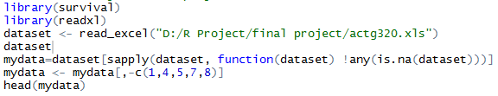
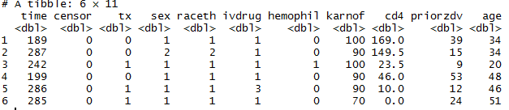

Slide 4
How to analysis:
1. select the best set of covariates in model
2. Assessing Goodness of Fit Using Residuals
Martingale residuals to check for the functional form of a covariate
Cox-Snell residuals for assessing the ﬁt of a Cox Model
Deviance residuals to detect potential outliers
Case deletion residuals to identify the eﬀect of each observation on the parameter estimate
3. Checking for the proportional hazards assumption

Slide 5
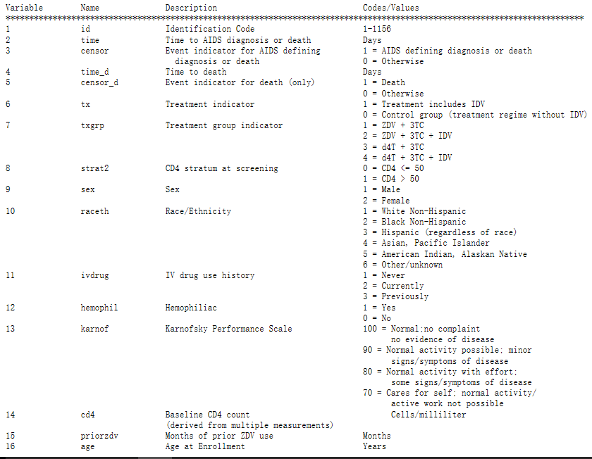

Slide 6
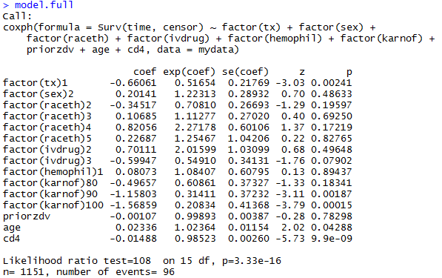
Full model:
Null Hypothesis: All the regression coeﬃcients are zero
The p-value <0.05 , so, the null hypothesis is soundly rejected

Slide 7
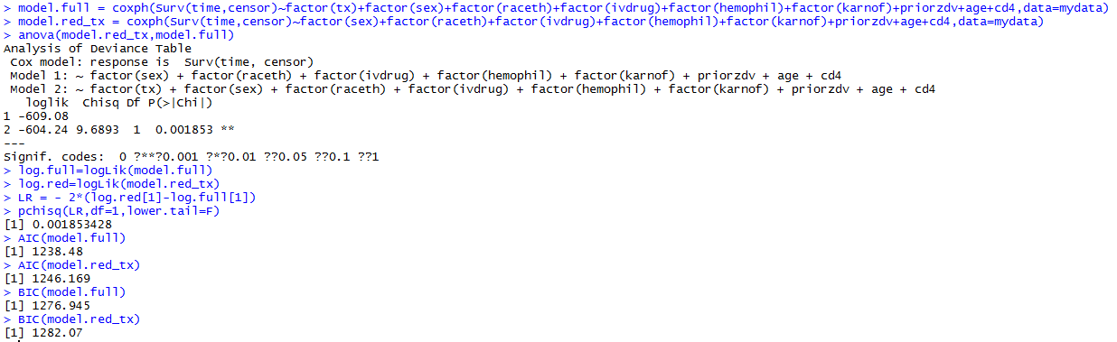
Check signiﬁcance taken tx as a single covariate
The diﬀerence in the number of parameters between the full model and the reduced model is 1 and as such the likelihood ratio test statistic is distributed as a chi-square random variable with 1 degrees of freedom. The p-value <0.05, so tx is significant as a single covariate at 5% level .

Slide 8
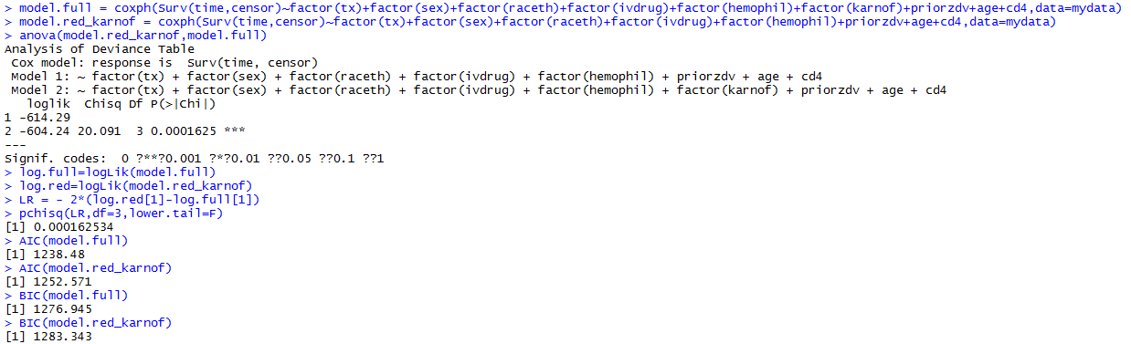
Check signiﬁcance taken Karnof as a single covariate
The diﬀerence in the number of parameters between the full model and the reduced model is 3 and as such the likelihood ratio test statistic is distributed as a chi-square random variable with 3 degrees of freedom. The p-value <0.05, so Karnof is significant as a single covariate at 5% level .

Slide 9

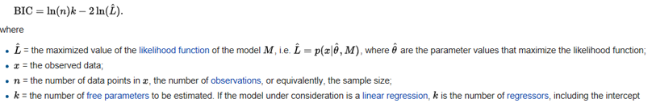
AIC and BIC

Slide 10
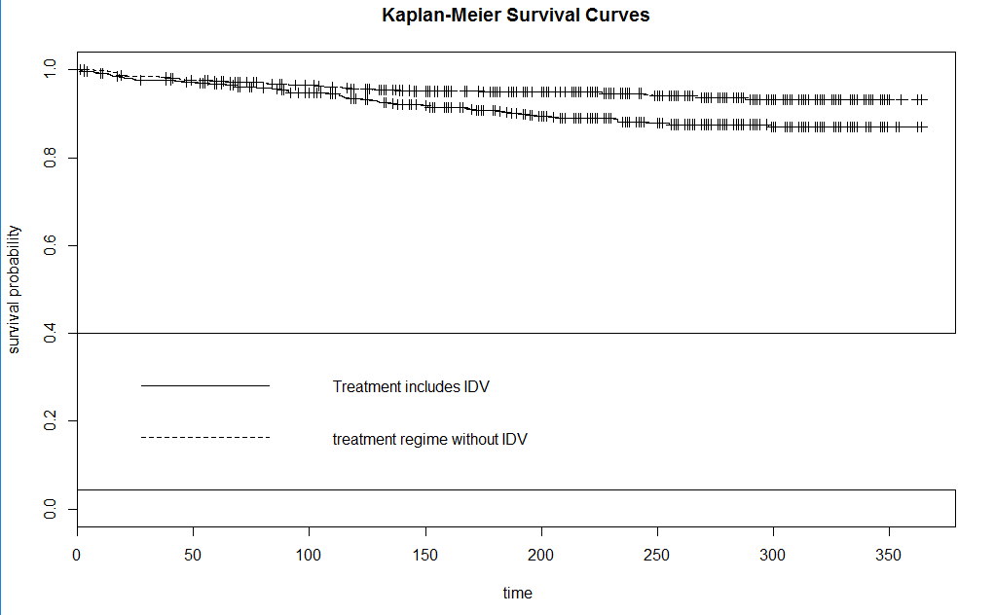
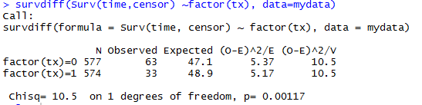
Check the difference between two treatment groups
Kaplan-Meier survival curve
Log rank test
The survival curve for the treatment with IDV group always lie above the survival curve for the without IDV group. So patients who received the treatment with IDV are expected to survive more than those who received without IDV .

Slide 11
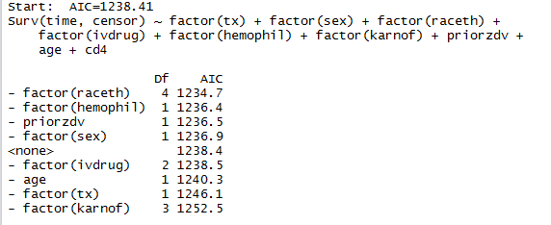
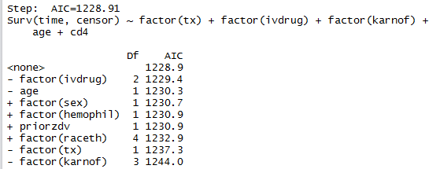
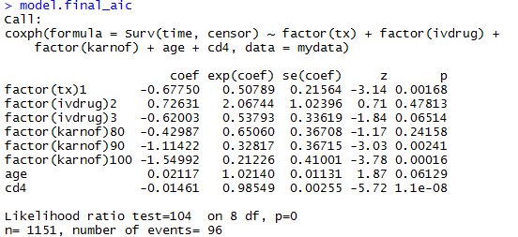
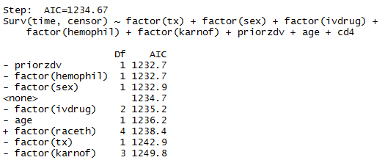
AIC:

Slide 12
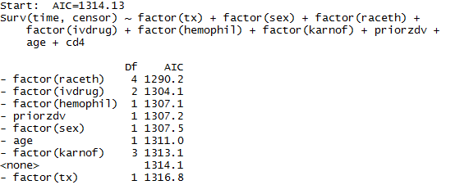
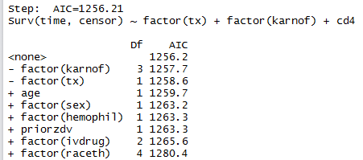
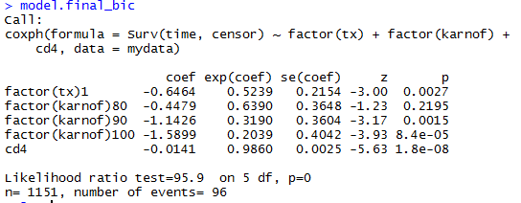
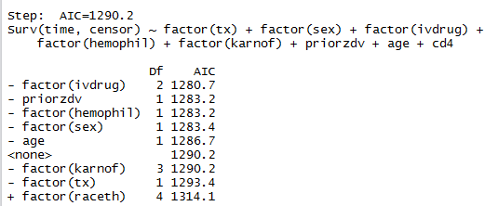
BIC:

Slide 13
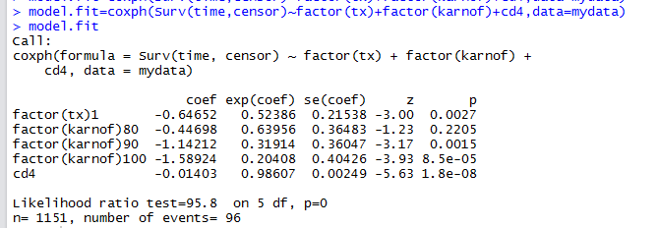
Choose BIC as fit model

Slide 14
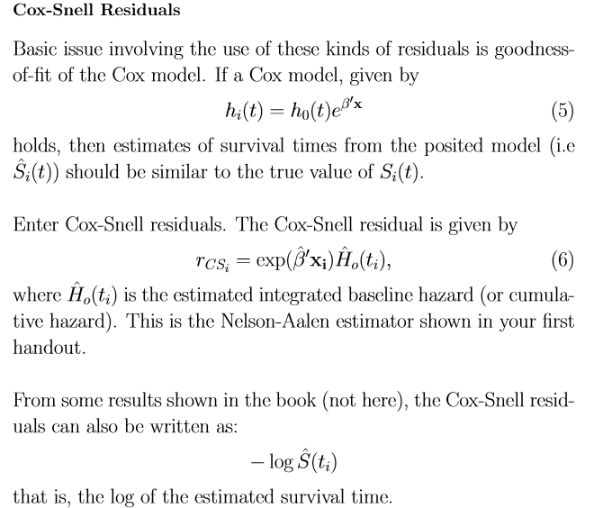
Cox-Snell residuals for assessing the ﬁt of a Cox Model

Slide 15
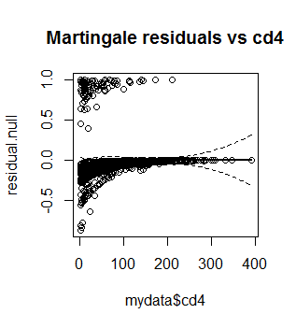
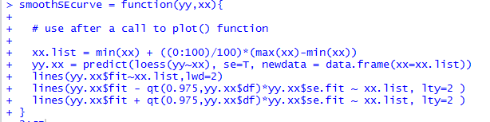
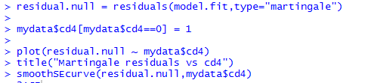
Martingale residuals to check for the functional form of covariate cd4
The untransformed variable cd4 show considerable linearity, no longer use log transformation

Slide 16
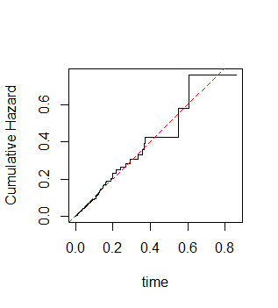

Cox-Snell residuals for assessing the ﬁt of a Cox Model
The plot suggests that the model does ﬁt good.

Slide 17
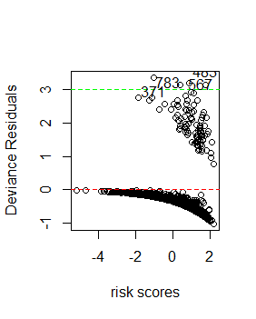
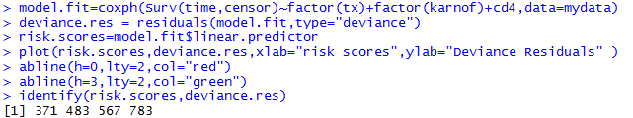
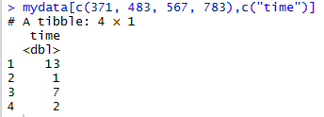
On inspecting the individual deviance residuals, observations 371,483,567 and 783 may be considered as potential outliers. On inspecting these observations, it turns out that these patients died at 13,1,7, and 2 month2 respectively. Hence, they can be considered as outliers because they were expected to have relatively long survival times but they were in fact, have very short lived patients

Slide 18
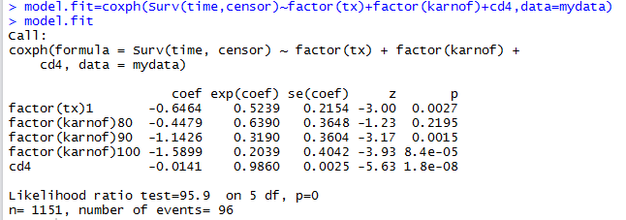
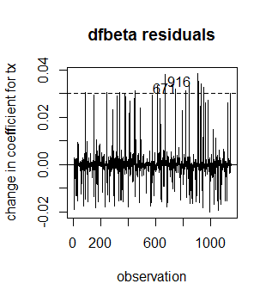

Identify eﬀect of each observation on tx estimate
None of the patients change the estimate of the coeﬃcient corresponding to “tx” by more than 0.003, which is 6.1% (0.04/0.6464) of the absolute value of the coeﬃcient. However, we still see that patients 67 and 916 are the most inﬂuential.

Slide 19
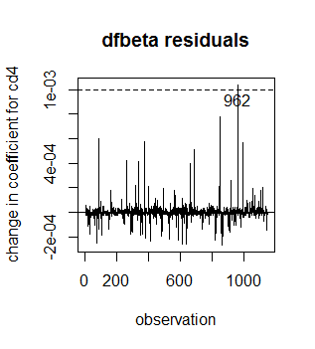
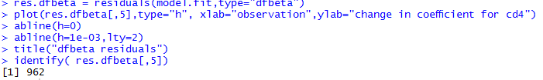
Identify the eﬀect of each observation on cd4 estimate
None of the patients change the estimate of the coeﬃcient corresponding to “cd4” by more than 0.002, which is 12.05%(0.002/0.01659) of the absolute value of the coeﬃcient. However, we still see that patients 962 has the most inﬂuential on the estimate of the coeﬃcient corresponding to “cd4”.

Slide 20
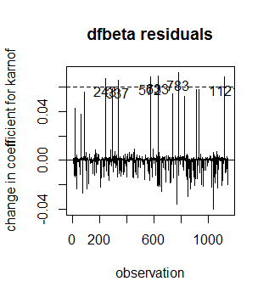
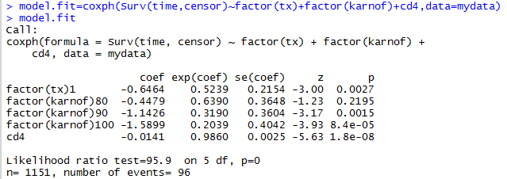
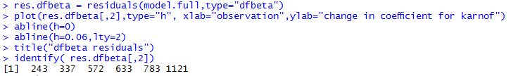
Identify the eﬀect of each observation on Karnof estimate
From the plot, it is clear that none of the patients change the estimate of the coeﬃcient corresponding to “Karnof” by more than 0.07, which is 13.4%(0.07/0.4479) of the absolute value of the coeﬃcient. However, we still see that patients 243,337,572,633,783,1121 are the most inﬂuential

Slide 21
Check proportional hazards assumption on variables
If we are comparing survival times between two groups, we can use the proportion hazard assumption. Under the assumption, we have S1(t)=[S0(t)]^EXP(β), where β is the proportional hazards constant. After two times of logs on both sides, we have log{-log[S1(t)]}=β+log{-log[S0(t)]. A plot of g[S1(t) and g[S0(t)] versus t or log(t) will yield two parallel curves separated by β is if the proportional hazard assumption is correct. Step 1. estimates of survival probabilities of patients belonging to separately 2. plot log cumulative hazard curves against their respective log of times

Slide 22
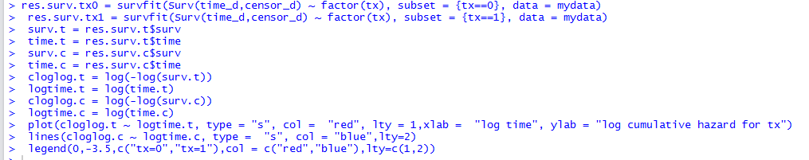
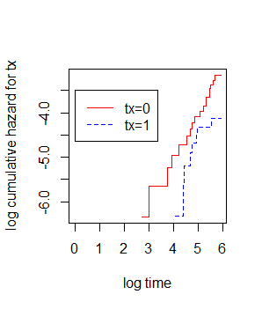
Check proportional hazards assumption on tx
the two curves are parallel ,so the proportional hazards assumption is satisﬁed here.

Slide 23
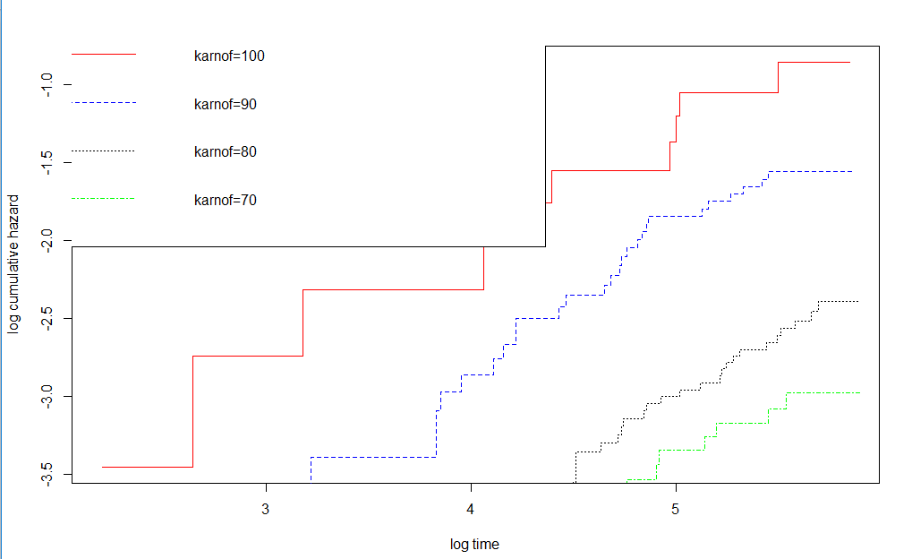
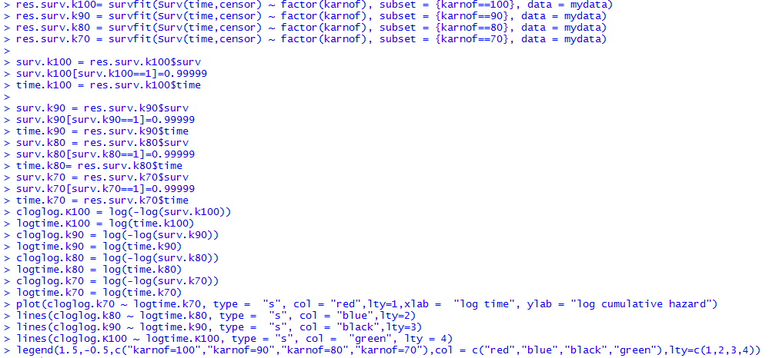
Identify the eﬀect of each observation on Karnof estimate
the curves are parallel , so the proportional hazards assumption is satisﬁed

Slide 24
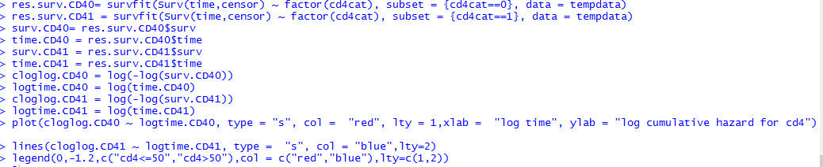
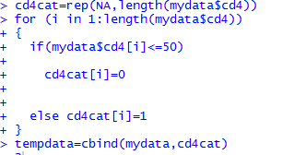
Check proportional hazards assumption on cd4 estimate

Slide 25
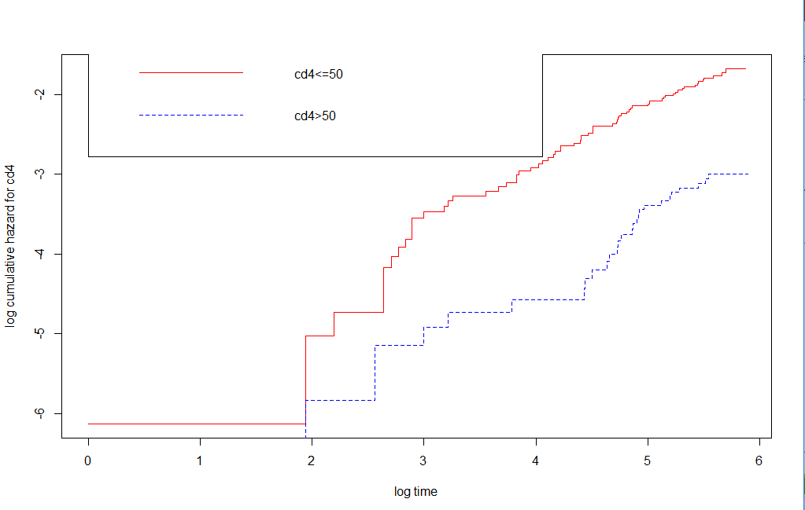
Graph:
the curves are not parallel , so the proportional hazards assumption is not satisﬁed

Slide 26
Conclusion:
1. tx, knarnof, cd4 are considered as the best set of covariates in model , and have significant effect on the survival time of AID patients.
2. Patients who received the treatment with IDV are expected to survive more than those who received without IDV

Slide 27
References:
https://www.umass.edu/statdata/statdata/data/actg320.txt

